Slide 1
Stephen P. Waltrip High School
10th and 12th Grade Class Meeting
Friday, September 1, 2023
Class of 2024 is determined to do more. #Determination

Slide 2
Welcome To Back to School Fall 2023 Semester
We Are Honored And Excited That Waltrip Is Your School Of Choice!

Slide 3
Stay Connected At The TRIP – Waltrip High School Canvas Courses for Class Of 2024 and Class of 2026 coming soon
Notes:
It is really important for families to stay actively engaged with Waltrip High School and the Class of 2023, as communication is a shared responsibility between the school and families, so we try to make it as easy and streamlined as possible. PowerSchool is a new student/ parent communication tool and when students log in, they see grades, attendance, learning preferences, etc. Our WHS Class of 2023 Canvas course, students will they see announcements tailored to their specific grade level, anything important that’s coming up, etc.
Of course we have a social media for seniors with the latest happening, so we encourage ya’ll like and follow both of those.

Slide 4
Today’s Agenda
Key Dates
Reminders
Attendance (Tardies and Absences)
Testing Dates
Registrar
Counselors
College Center
Wrap Around

Slide 6
Key Dates
August 28 – October 2, 2023: First Six Weeks Grading Cycle
October 3 – November 10, 2023: Second Six Weeks Grading Cycle
November 13 – December 22, 2023: Third Six Weeks Grading Cycle

Slide 7
Key Dates
August 31 – September 11, 2023:
Schedule Changes
September 8, 2023:
Homecoming Game
September 9, 2023:
Homecoming Dance
SEptember 4, 2023:
Labor Day Holiday

Slide 8
Key Dates
September 5 – 8, 2023
Off Campus form (all lunches)
September 25, 2023: FALL HOLIDAY
LAST FRIDAY IN APRIL 2023:
PROM
June 2024:
Graduation

Slide 9
Reminders
Parking Permits (Seniors)
Off Campus/Early Release (Seniors)
Dress Code
Tardies
Off Campus Lunch (2nd six weeks)

Slide 10
Attendance Appeal Process 2023-2024
What Causes NGs?
Excessive absences
Missing more than 10% of your class or classes.
What you can DO!
Be in class every day on time
Pay attention to report cards (*)
If absent bring an Dr’s note/excuse
The Attendance Credit Appeal process is requirement for any student that hAVE received a no gRADE (NG) on their semester report card OR transcript.

Slide 11
Attendance Counts!
Questions Start With You Grade Level Administrator Or Assistant.
State law TEC §25.092 and Houston ISD policy still require students to attend at least 90% of their classes to receive credit and be promoted.
HISD Attendance Policy
Students returning from an absence must bring a written note from a parent/guardian or physician validating the reason for the absence, WITHIN THREE (3) DAYS, to Ms. Guidry in the Attendance Office in order to record the absence as EXCUSED.
Attendance Clerk: Glenda GuidRy Email: GGuidry@HoustonISD.org

Slide 12
Attendance Appeal Process 2023-2024
DEADLINE
All NGs earned in the 22-23 SY must be cleared
October 3, 2023
If All NG’s are not Cleared by the deadline date you will be required, the take the class or classes over.

Slide 13
Testing Information
PSAT - Week of October 9-14th, 2023
KHAN Academy
Collegeboard.org
Texas Bridge
TSIA2 - Fall 2023
APEX
Accuplacer.collegeboard.org

Slide 14
Testing Information
Cred-by-Exam (CBE) - September 25 – October 14, 2023
To determine if students qualify for advance
SAT School DAy - October 11, 2023
STUDENTS WILL BE NOTIFIED
APEX
Accuplacer.collegeboard.org

Slide 15
Testing Information
STAAR – STAAR EOC Assessment
April 18, 2023 – English I
April 19, 2023 – English II
April 25, 2023 – US History
April 27, 2023 – Biology
May 2, 2023 – Algebra I
TELPAS
February 20 – March 6, 2023
ADVANCED PLACEMENT ASSESSMENTS
May 1 – May 11, 2023
ACT – Spring 2023
ACT.org (Free test prep Guide for 2023)
TSIA2 - Spring 2023
Khan Academy
Accuplacer.collegeboard.org
ACT Test Date | Registration Deadline | Late Registration Deadline
April 2, 2023 | March 10, 2023 | March 24, 2023

Slide 16
Registrar’s Corner
Credits
6 or more 10th Grade
12 or more 11th Grade
18 or more 12th Grade
At least 26 to Graduate
Transcripts
All Classes Attempted (Pass, Fail, NG’s)
STAAR Scores
Industry Certification
Sheryl Smith ssmith41@houstonisd.org

Slide 17
Counselor’s Corner
10th Grade Counselor
Ms. Anita Griffin
(AGRIFFI2@HOUSTONISD.ORG
12th Grade Counselor
Ms. Yonsuetta Johnson
(YJOHNSO1@HOUSTONISD.ORG)

Slide 21
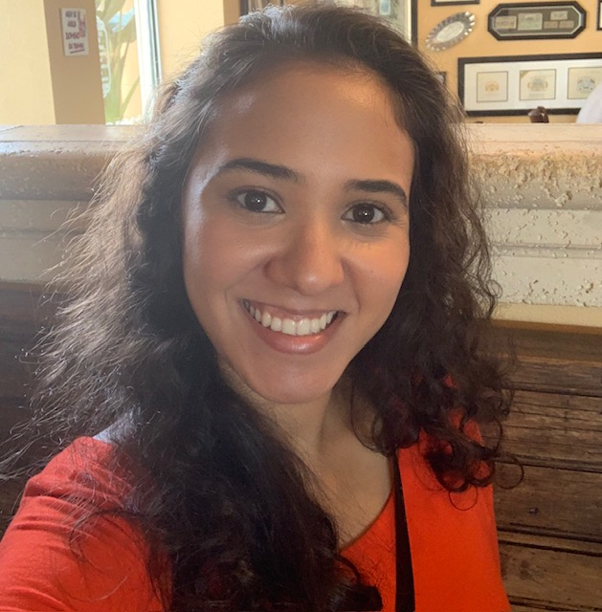
Communities in schools
Alison Flores
Office 3204
713-688-1361 ext. 248

Slide 22
Wraparound Services
WrapAround TBA
Wraparound Resource Specialist, Waltrip High School
Office: Office Suite 3204| Office Number: 713-688-1361 x015141

Slide 23
Thank you
10th grade office 3116
12TH GRADE OFFICE 3107
Dr. Warren Anderson - Dean
Anita Griffin - counselor
Yesely Molina – administrative assistant
ALAN k. Moore – Dean
Yonsuetta Johnson – counselor
Guadalupe rios – administrative assistant

